Slide 1
ABOUT MYSELF
Ahmad Hassan 23960

Slide 2
Introduction
A social activist, a public & persuasive speaker, an event organizer, a marketing professional, and a retail store owner. I serve as the president for a private organization named ‘EDGE Events’. With my expertise in event management, we hosted concerts from Atif Aslam and Ali Zafar in Multan. I have served as a founder & a director general of Flex’17, the very first private olympiad in Multan. I have also served in various positions concerning event management (refer to my work experience), and as a marketing and logistics intern. Being able to participate in the field of social welfare, I have worked with an NGO named ‘Help The Helpless’ for poverty alleviation and humanitarian relief. Initiating a business taught me how the dynamics of the industry are determined by the nation’s economic and trade policies. My own research, certifications from Google, Coursera, and other online sources give me the opportunity to test my creativity through articles and books and applying them practically. I learn to manage multiple jobs of various sorts (event organizing, brand management, behavioral economics, decision making, debating, and others on a basic level) by allocating them to my peers that trigger me to employ my administrative and communication skills.

Slide 3
Educational background
Primary Education : Bloomfield Hall School Multan ( 2004 – 2015 )
O‘levels in Sciences : Beaconhouse Newlands Lahore ( 2015 – 2018 )
Intermediate in Commerce : Private Student ( 2018 – 2020 )
Bachelors in Business Administration : Institute of Business Administration Karachi ( 2021 – Present )

Slide 4
Skills
Project Management
Financial Management
Business Planning
Budgeting
Business Development
Srategic Selling
Marketing Strategy
Operations Management

Slide 5
Work History
Retail Store Owner - X Mart Lahore : Working with multiple brands on board including Hermès, GNC, Nike, & Speed Sports.
EDGE Events Multan : Hosted Atif Aslam and Ali Zafar in concerts, Planned large-scale events such as trade shows, conferences, and meetings, & Delivered smooth training execution by coordinating site selection, marketing, event management and follow-up.

Slide 6
Certifications
Learning How to Learn for Youth, Arizona State University
Viral Marketing and How to Craft Contagious Content, University of Pennsylvania
Campaign Manager Certification Exam, Google
Google Analytics Individual Qualification

Slide 7
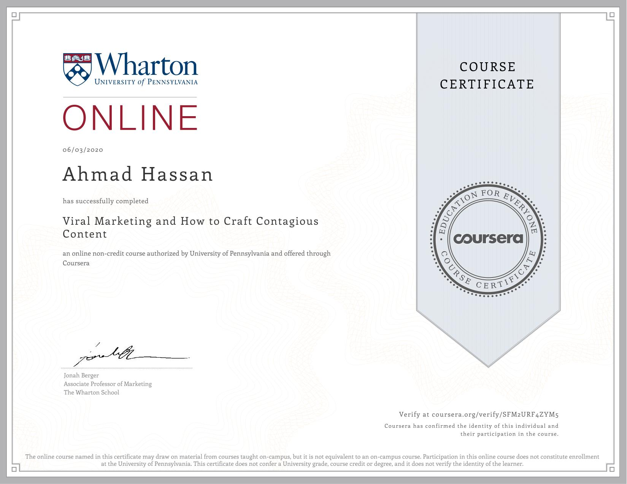
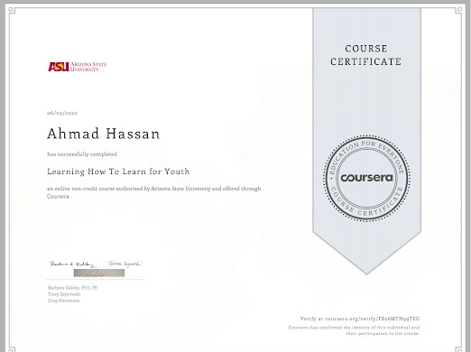
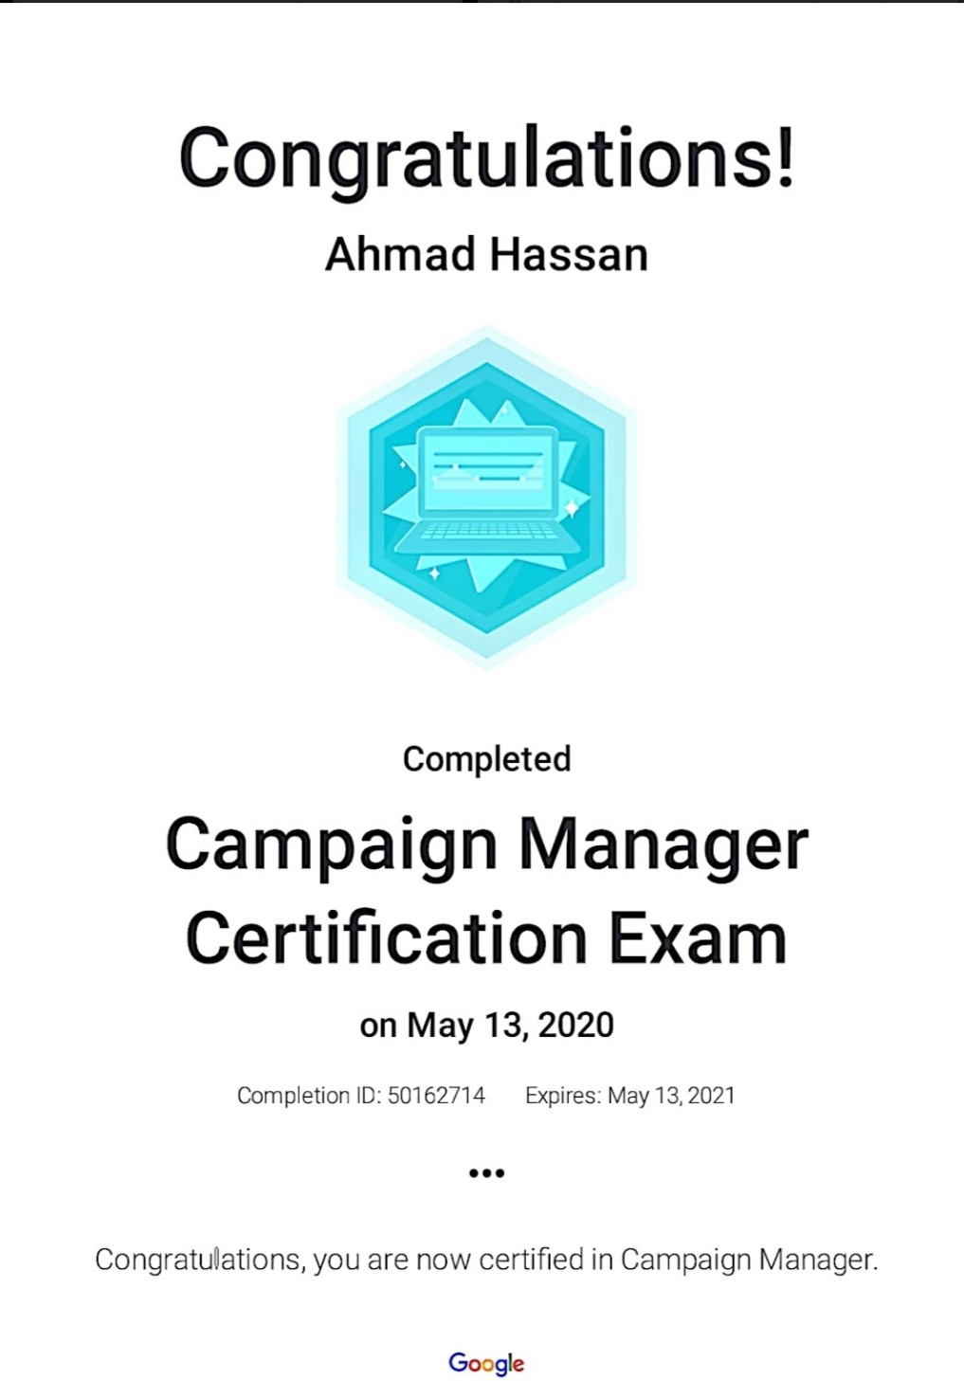
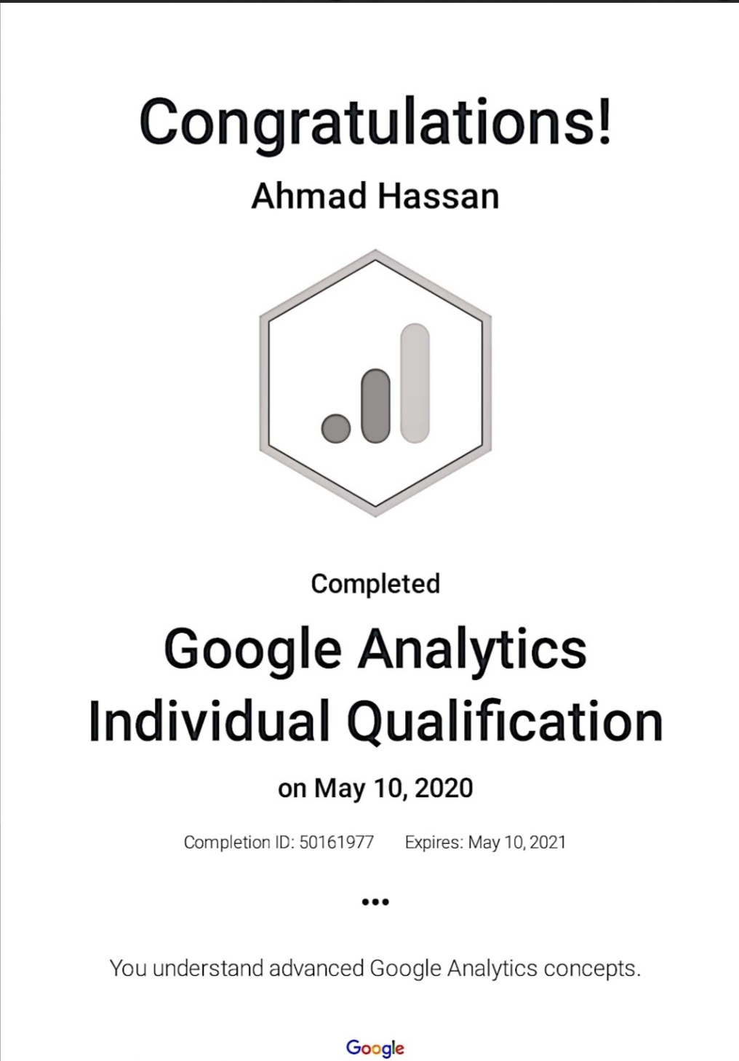
Certificates

Slide 8
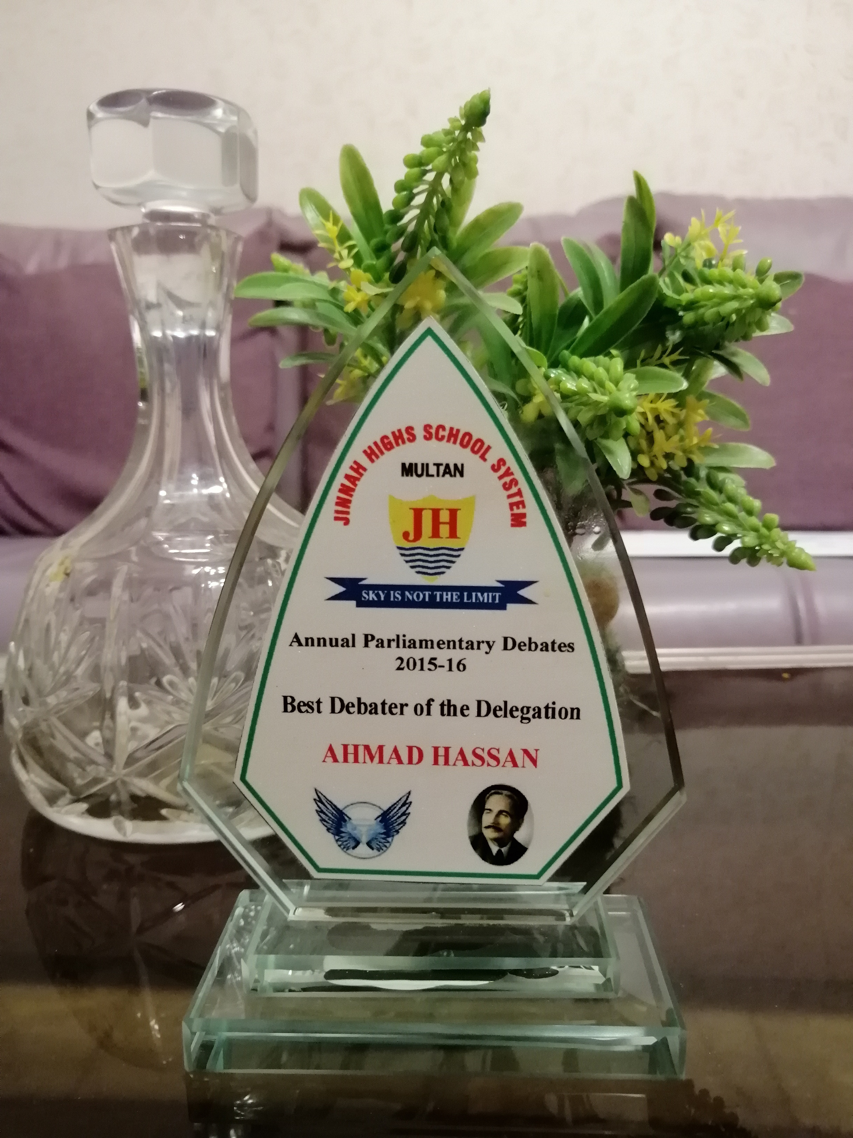
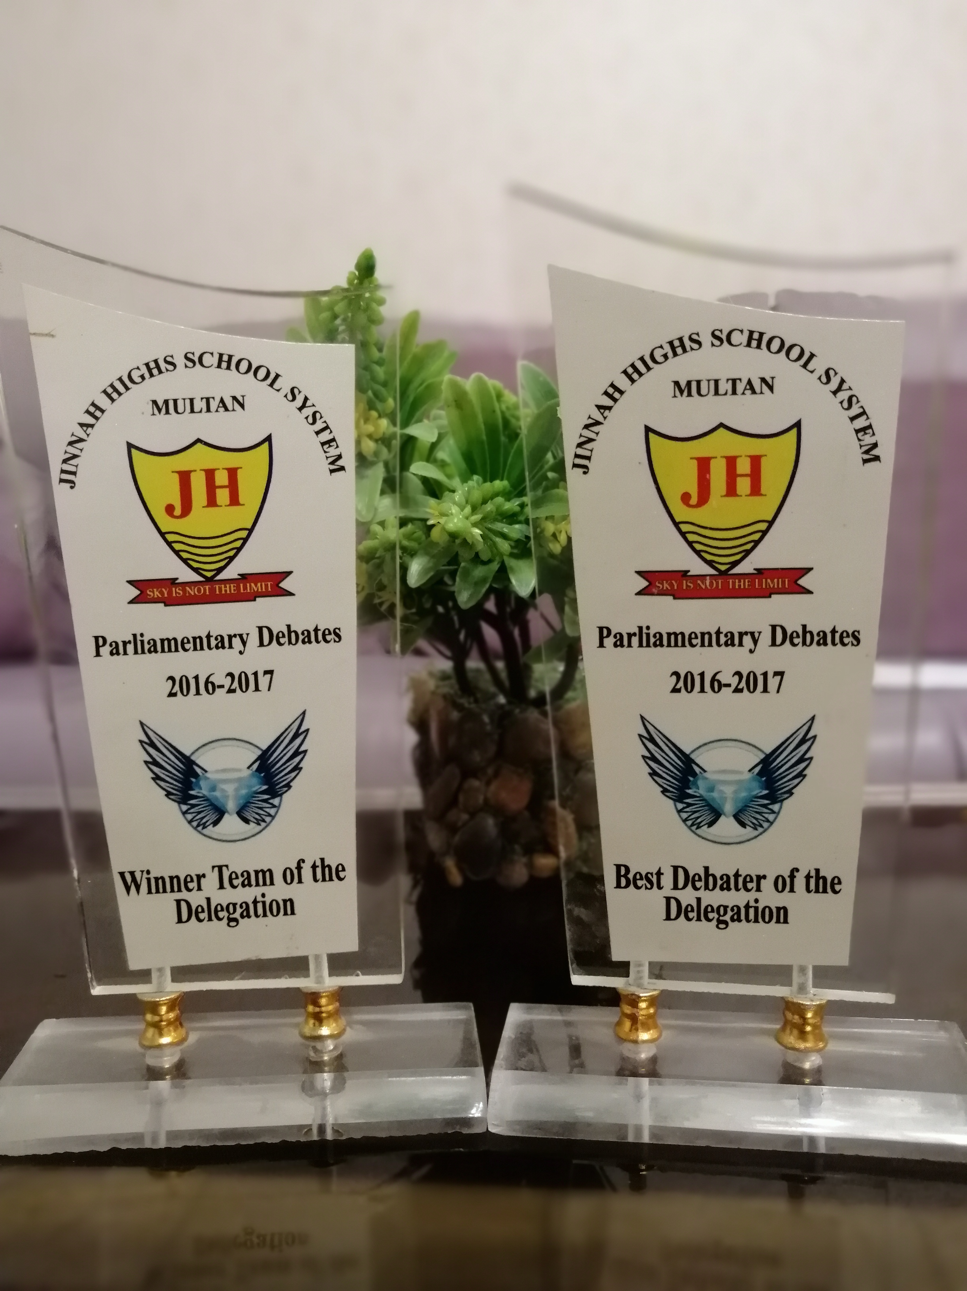
Achievements & Awards
Best Debater of Delegation ( JH Debates 2015 – 2016 )
Best Debater of Delegation ( JH Debates 2016 – 2017 )

